Slide 1

syngo.via pour l’Imagerie Moléculaire Technologies ALPHA et EQPET
Imagerie Moléculaire

Slide 2
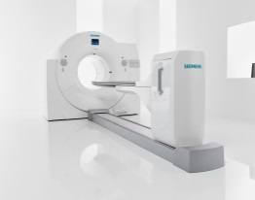
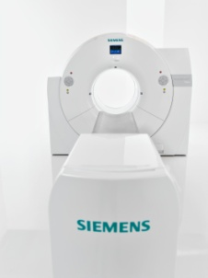
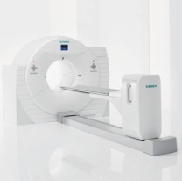
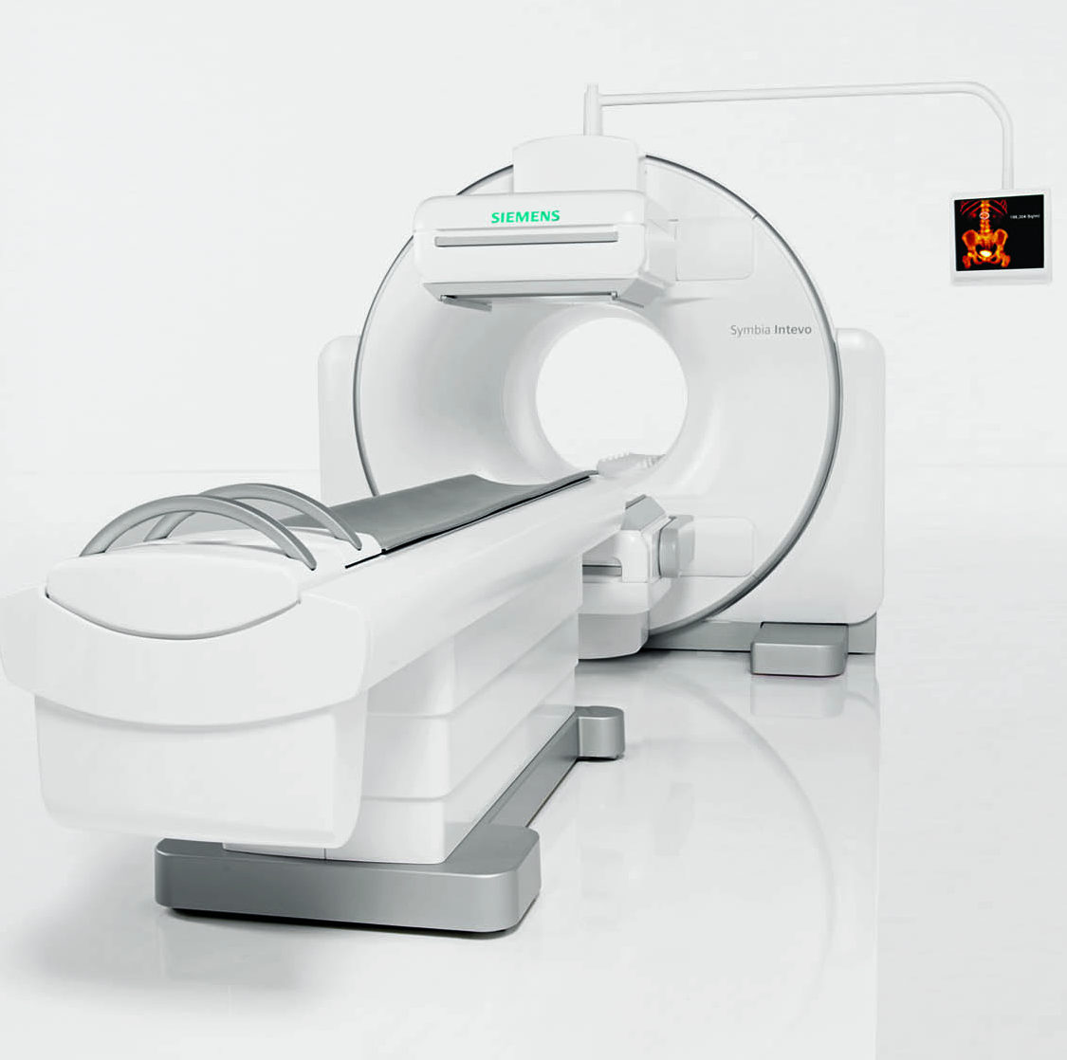
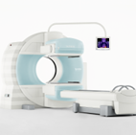
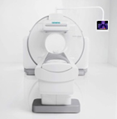

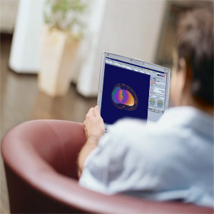
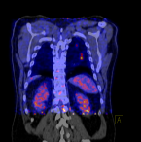
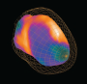
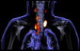
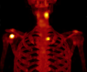
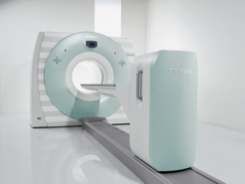
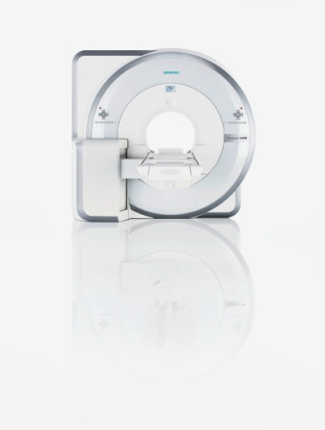
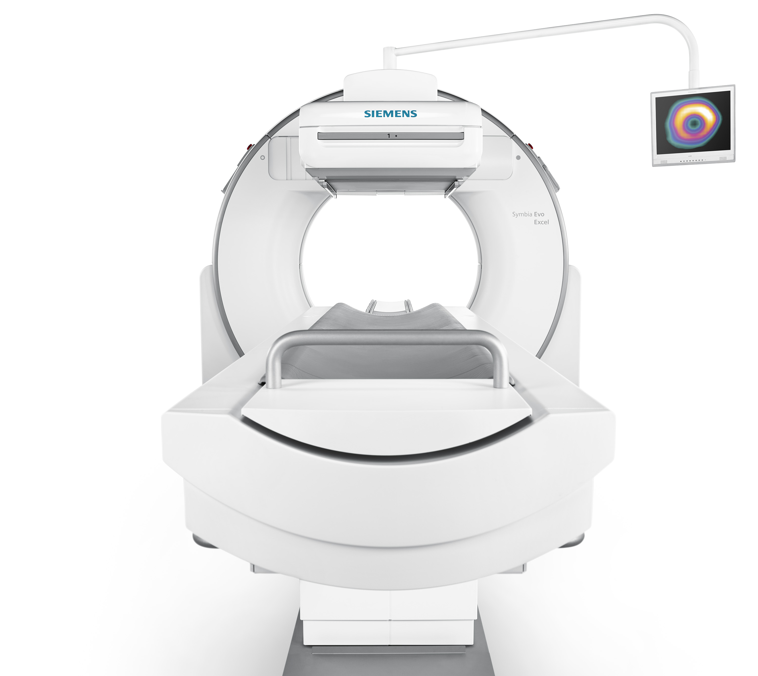
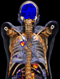
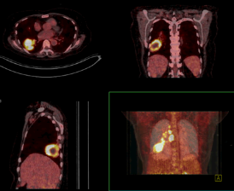
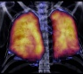
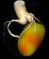
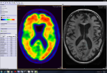
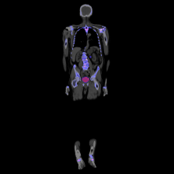
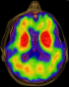
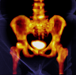
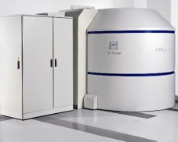
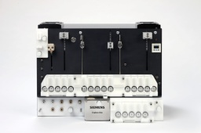
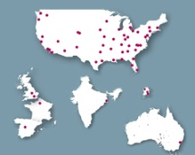
Siemens Imagerie Moléculaire
Biograph™
Symbia™
mCT Flow Edge
mCT Flow™
mCT
Intevo™
T Series
Intevo Excel
syngo®.via
Symbia.net
mCT 20 Excel
Annonce EANM
mMR®
Symbia Evo
Evo™ Excel
Biomarkers
Eclipse™ Explora One™ PETNET Solutions
Customer Care

Slide 3
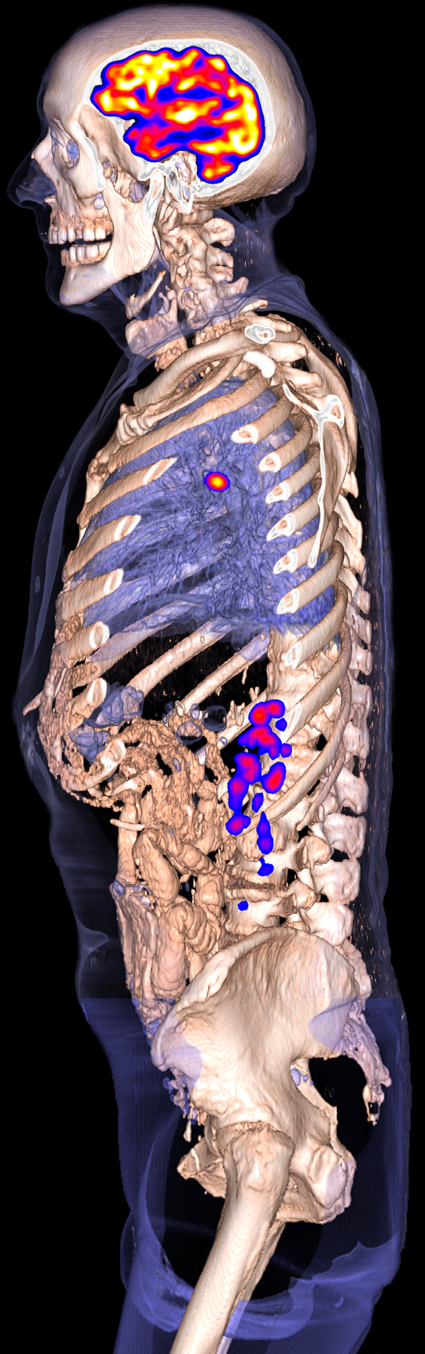
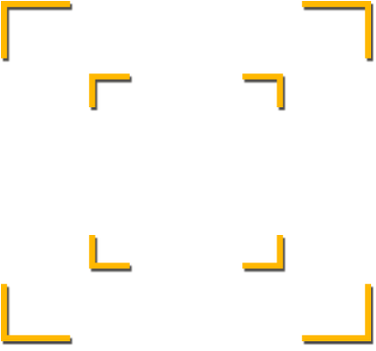
syngo.via Transformer de nombreuses données en résultats brillants
Lecture
Par organe*
Quantifier
*Basé sur les mises en pages MI SMART.
**Basé sur MI EQ•PET et les outils quantitatifs focntionnels.
Notes:
syngo.via for Molecular Imaging: Transforming Data into Brilliant Results
Our unique selling points –
Read Organ-based – SMART Layout and ALPHA
Quantify Reference-based – Quantification tools and EQ•PET
Report Evidence-based – Findings Navigator and evidence reporting

Slide 4
syngo.via Transformer de nombreuses données en résultats brillants
Lecture
Par organe*
*Basé sur les mises en pages MI SMART.
**Basé sur MI EQ•PET et les outils quantitatifs focntionnels.
Notes:
syngo.via for Molecular Imaging: Transforming Data into Brilliant Results
Our unique selling points –
Read Organ-based – SMART Layout and ALPHA
Quantify Reference-based – Quantification tools and EQ•PET
Report Evidence-based – Findings Navigator and evidence reporting

Slide 5
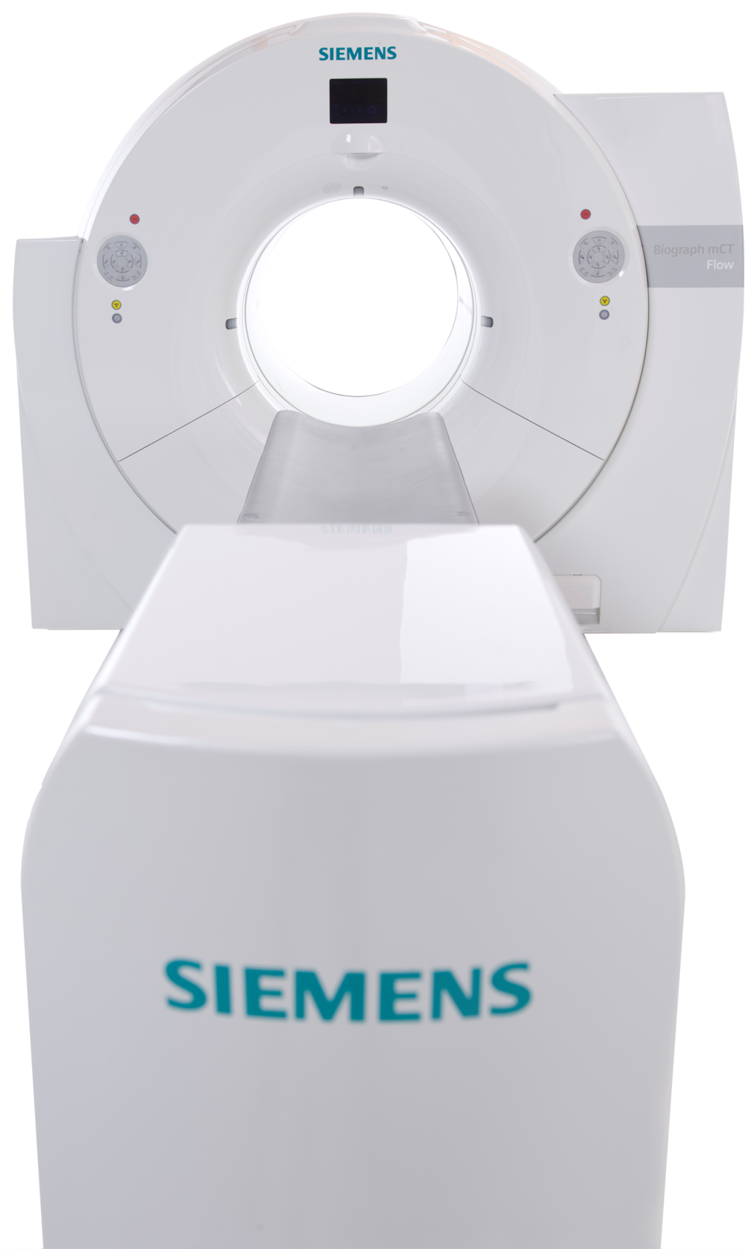
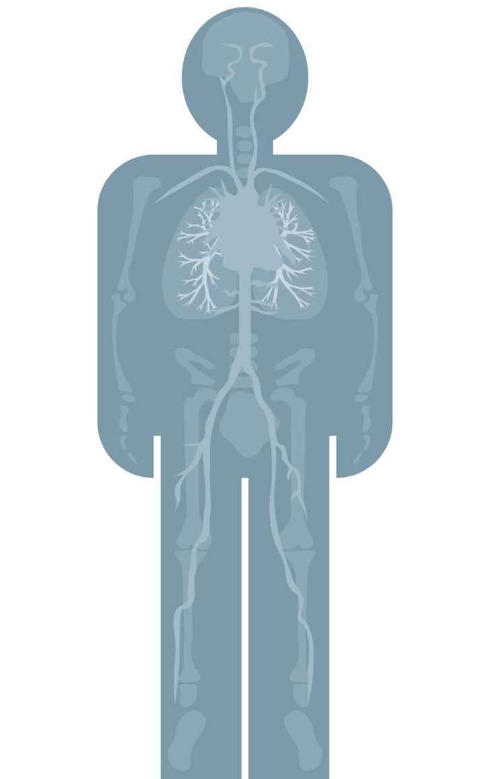

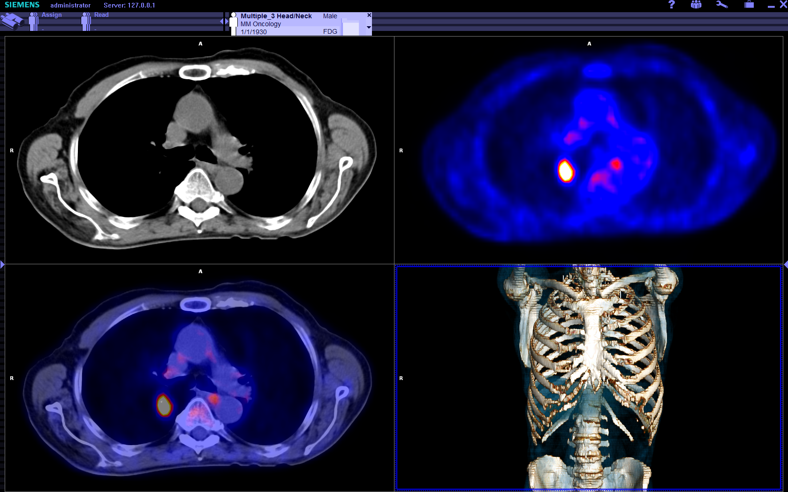
Lecture par organe Mise en page SMART disponible pour les protocoles Biograph mCT Flow smart
Mise en page SMART
Zone 1 Augmenter la Résolution
Augmenter la Résolution
Zone 2 Reduire le Mouvement
Réduire
le mouvement
Smart Protocole
Zone 3
Augmenter le Contraste
et la Vitesse
Augmenter le Contraste
et la Vitesse
Notes:
Biograph mCT Flow enables Organ-based scanning.
The scanner integrates organ information into Siemens DICOM header and sends it to syngo.via.
SMART Layout automatically translates this information into the physician-specific layout.
SMART Layout ensures that the physician reviews all available information and can FOCUS ON ORGAN-SPECIFIC READING immediately after opening the case.
This is unique to Siemens and solves the problem for our customers!
De plus en plus d’examens sont à interpréter.
Nécessaire d’automatiser des taches longues et non essentielles comme la préparation des études multipoints pour comparer lors de l’interprétation.

Slide 6
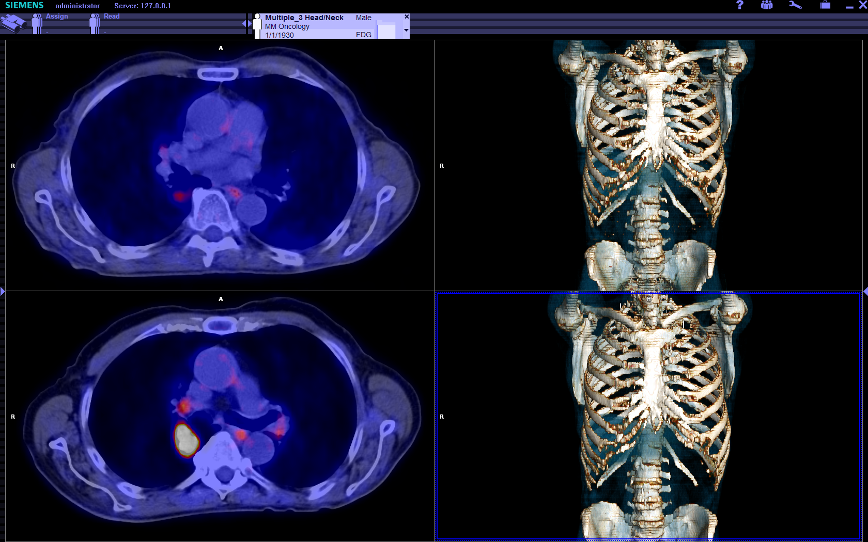
Lecture par organe Les études en suivi thérapeutique nécessitent un recalage précis entre les examens
Notes:
In Molecular imaging, many cases are follow-up studies that require proper alignment of images with each other.
Lors d’un suivi thérapeutique PET/CT, c’est une analyse visuelle mais également quantitative dont les obstacles sont le recalage (tache fastidieuse et manuelle) et lors de quantification PERCIST le placement d’une ROI de référence dans le lobe droit du foie ou de l’aorte descendante qui est une tache ennuyeuse.

Slide 7
Lecture par organe Le décalage entre examens pourrait être la cause d‘une disparition d‘une lésion
Recalage conventionnel
Notes:
Misalignment or misregistration may cause lesions to visually disappear.

Slide 8
Lecture par organe La technologie ALPHA reconnait des marqueurs anatomiques
Recalage ALPHA
Notes:
SOLUTION
Multiple Time Points - Landmark Registration: syngo.via ALPHA technology includes algorithms that automatically identify up to 28 anatomical landmarks. This allows an intelligent registration between multiple exams, either from CT, MR or PET/CT, almost like a physician would do visually. This transforms the alignment of images from multiple sources from registration to recognition.

Slide 9
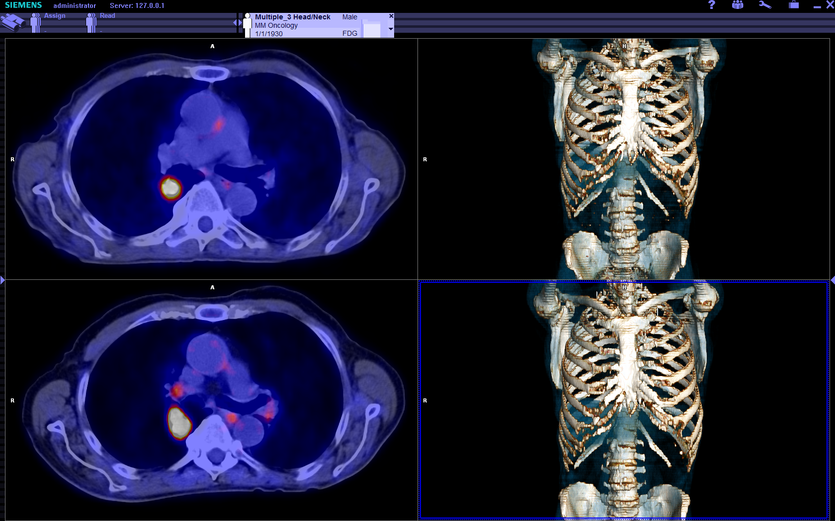
Lecture par organe La technologie ALPHA corrèle automatiquement l‘anatomie pour un relacage précis
RecalageALPHA
Notes:
BENEFIT:
Multiple Time Points - In multi-time point cases with ALPHA technology, prior studies are all registered with each other even when derived from multiple different sources.

Slide 10
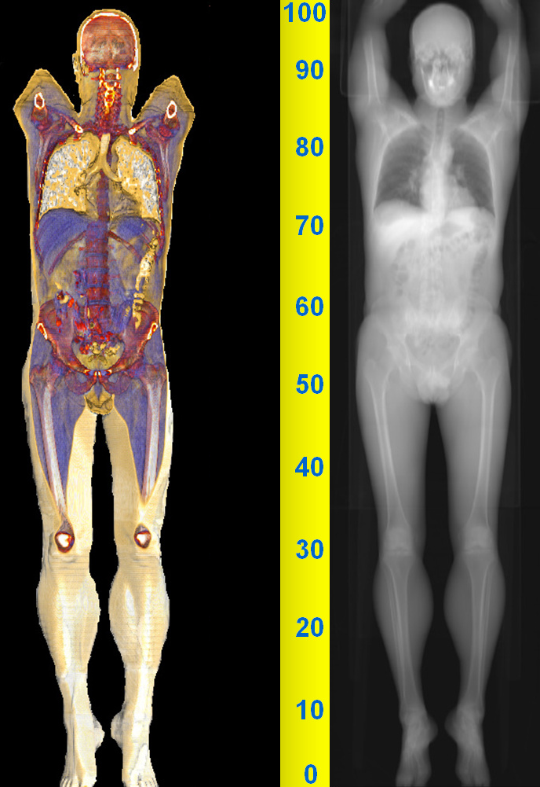
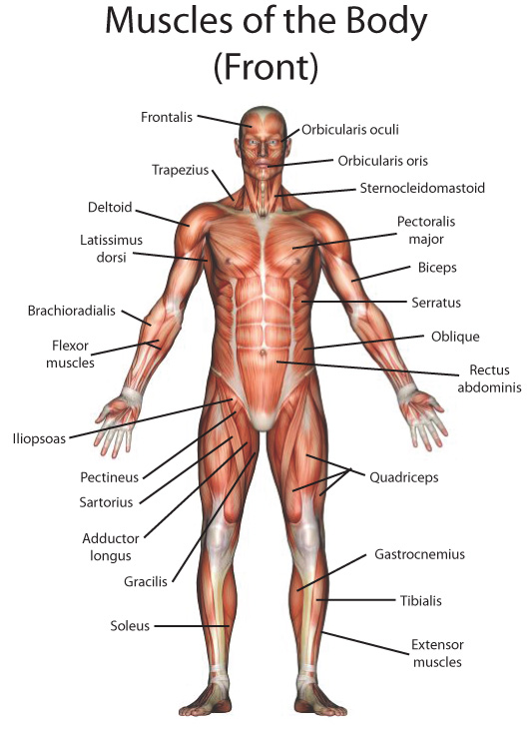
Technologie ALPHA Objectif: du recalage vers la reconnaissance anatomique
Teach
Human
Anatomy
Notes:
ALPHA technology has been created with the goal of teaching human anatomy to syngo.via.
With that, anatomical landmarks could be identified and aligned even with deviations from disease, position and even modality!

Slide 11
Technologie ALPHA Etat de l’art d’un système intelligent avec un modèle de reconnaissance
Automatic
Landmarking and
Parsing of
Human
Anatomy
Notes:
So what does ALPHA stand for?
ALPHA stands for
Automatic
Landmarking and
Parsing of
Human
Anatomy
It means that the software is screening images and comparing them to known structures to identify anatomical landmarks.

Slide 12
Technologie ALPHA L’algorithme ALPHA apprend à partir d’exemples annotés par des experts
Automatic
Landmarking and
Parsing of
Human
Anatomy
Notes:
But how can we teach the software human anatomy?
We are using the best teachers there are: physicians!
They mark up target anatomical structures on hundreds of scans for the computer to learn its features.

Slide 13
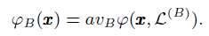
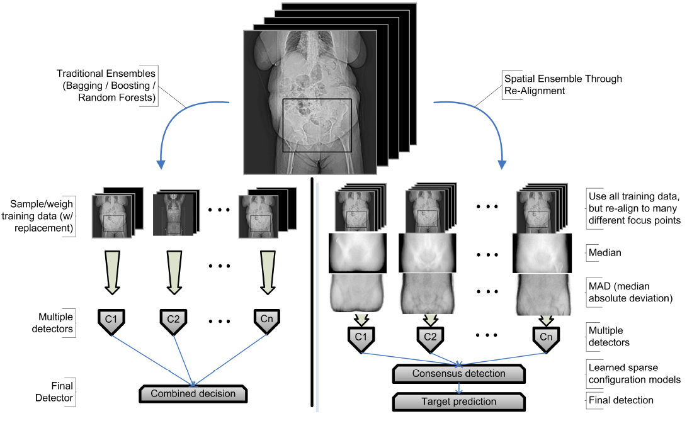
Technologie ALPHA L’algorithme ALPHA apprend à partir d’exemples annotés par des experts
C1
C1
C1
Averaged Decision
Notes:
One way for the computer to decide on anatomy is by averaging the results of its algorithms (detectors).

Slide 14
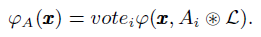
Technologie ALPHA Redondance robuste : tous les points de repères sont à la fois des votants et des candidats
C1
C1
C1
Concensus Decision
Notes:
However, we used a more robust approach by using a voting mechanism to arrive at a consensus decision.

Slide 15
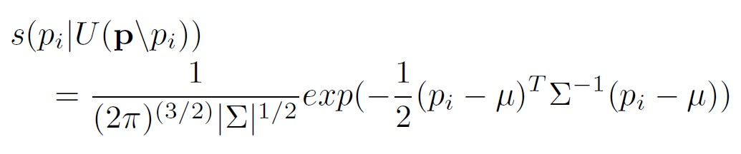
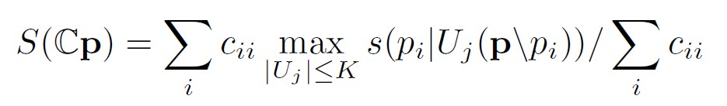
Technologie ALPHA La redondance fournit robustesse et une haute fiabilité
C1
C1
C1
Concensus Decision
Notes:
This makes the end result significantly more resilient to changes from disease and other factors.

Slide 16
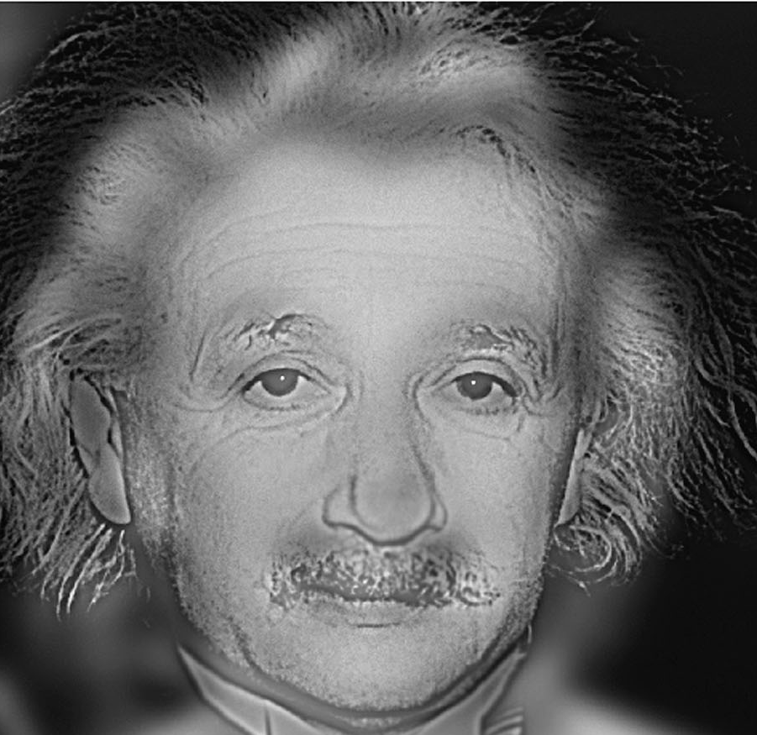
Technologie ALPHA La redondance est aussi appliqué dans l’échelle image
Notes:
Secondly, we also apply the concept of redundancy in the scale space.
What is the scale space?
Look at this example: Do you recognize the person? Looks like Einstein. However, once we start changing the scale, a different result may emerge…

Slide 17
Technologie ALPHA Haute fiabilité et précision
97% Sensibilité
99% Précision
40 points de repères x
400 données TEP/TDM
16,000 tests
Source: Jens N. Kaftan : Validation of SY’s vs. SCR landmark detection technologies on PET/CT datasets
Notes:
With all the built-in redundancy and robustness, ALPHA can achieve:
97% sensitivity in detecting anatomical landmarks and
99% accuracy that the detected landmarks are the right ones (Jens N. Kaftan : Validation of SY’s vs. SCR landmark detection technologies on PET/CT datasets)
To get to this point for PET/CT, we have performed 16,000 test runs.

Slide 18
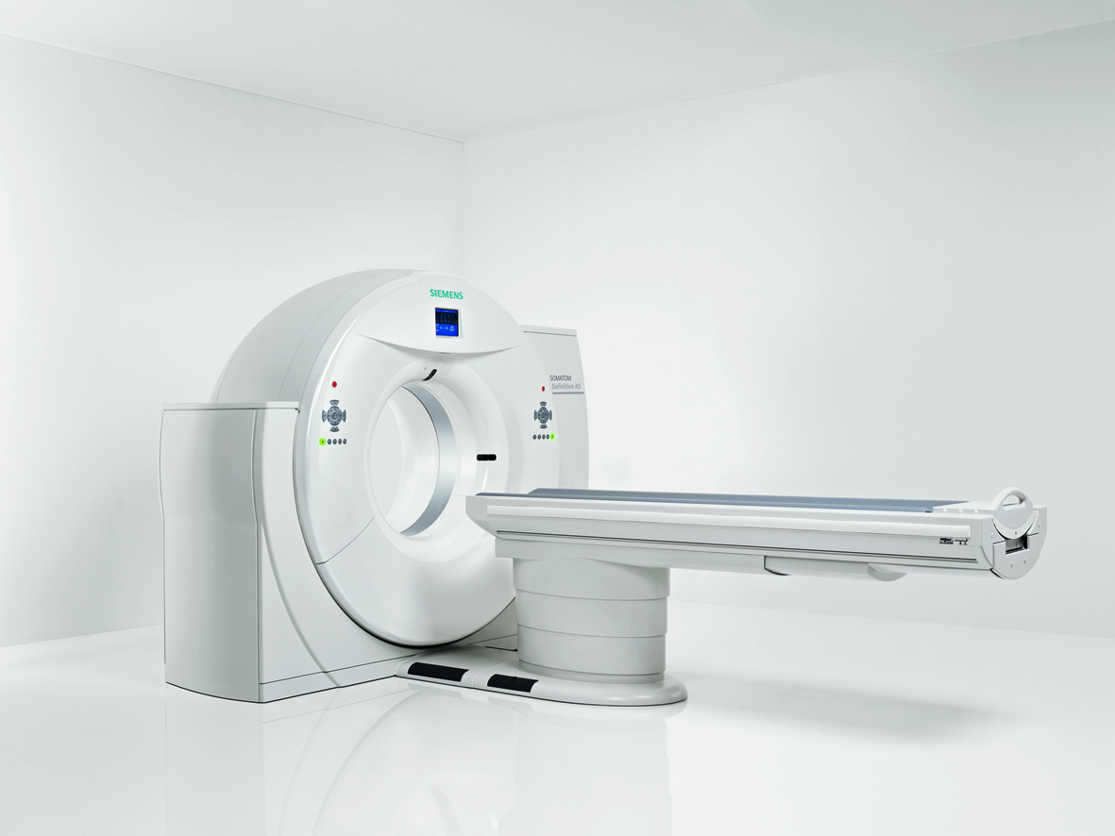
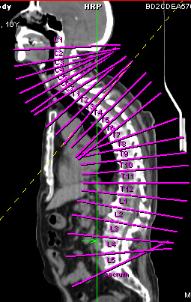
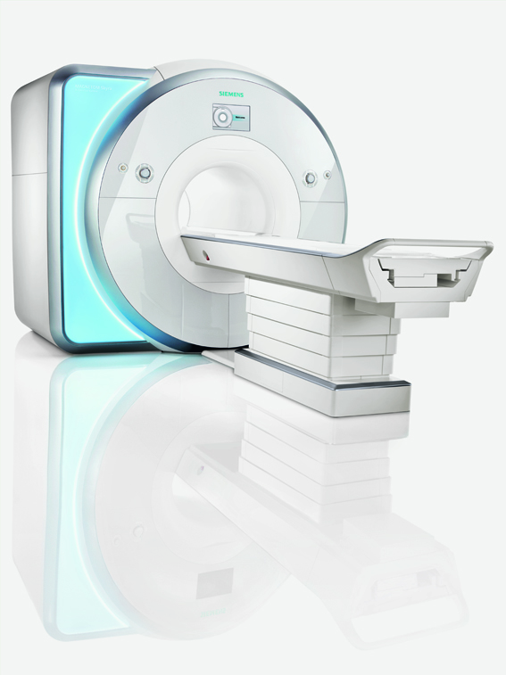
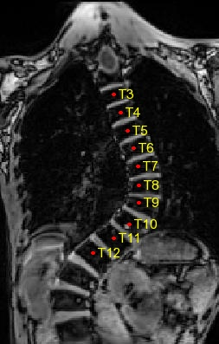
Technologie ALPHA Navigation entre modalités
CT
MR
Notes:
ALPHA Technology opens up exciting applications in CT, MR and PET! It is nothing short of a cross-modality navigation system for the human body!
It has been proven in CT and MR, for example with these automatic spine labelling applications. Notice how ALPHA detects vertebras even in these examples that are strongly deformed by disease!

Slide 19

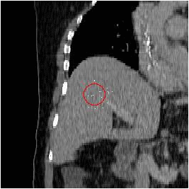

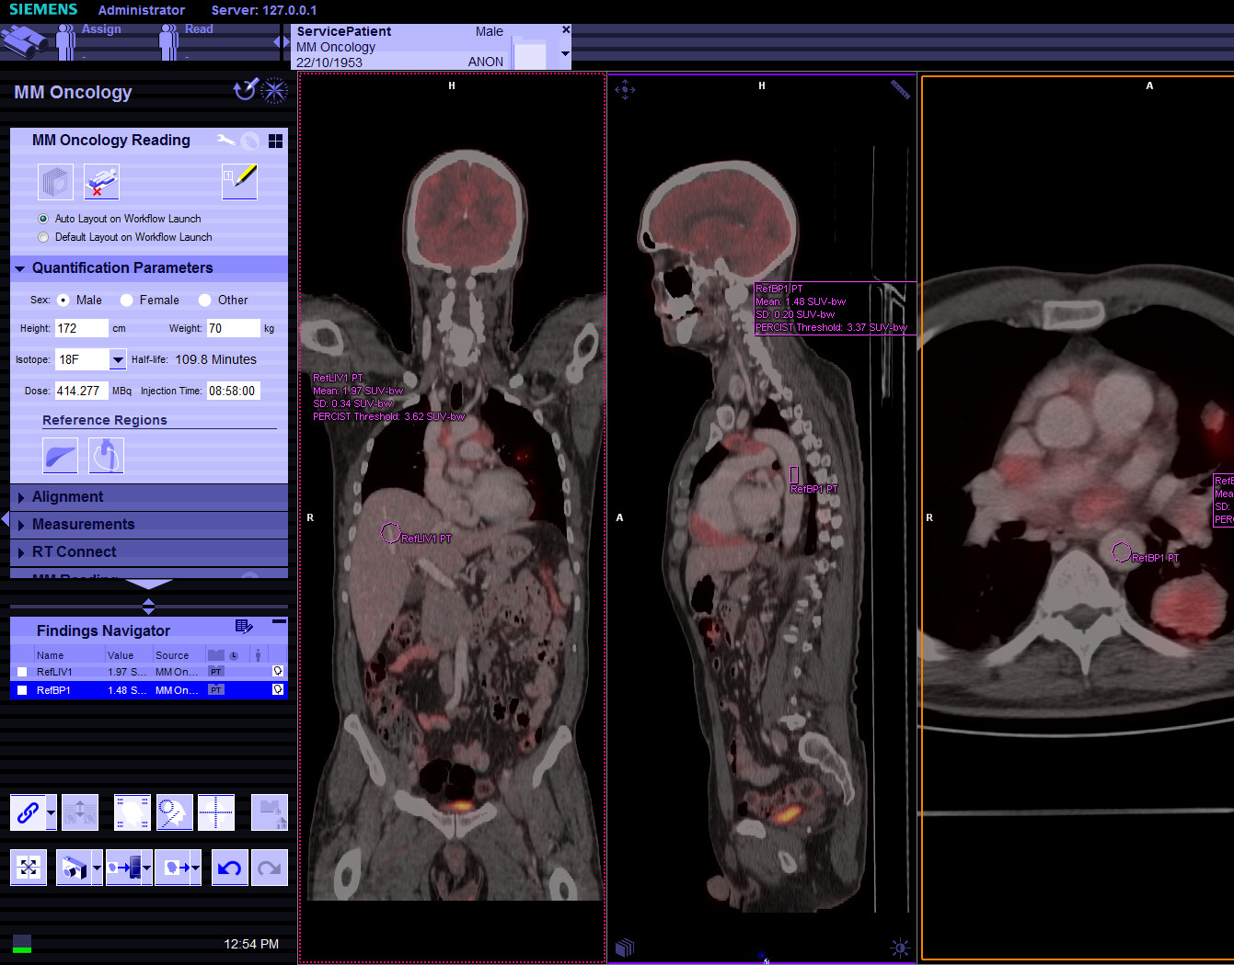
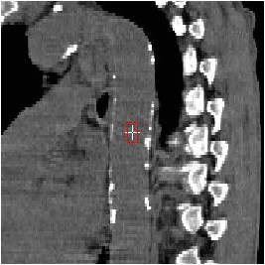
Technologie ALPHA Navigation entre modalités
ALPHA Inside
Notes:
In PET/CT, which was more complex to implement, you can now benefit from such critical applications as automatic blood pool and liver detection required for SUV_{peak} calculations as well as accurate registration across time points!

Slide 20
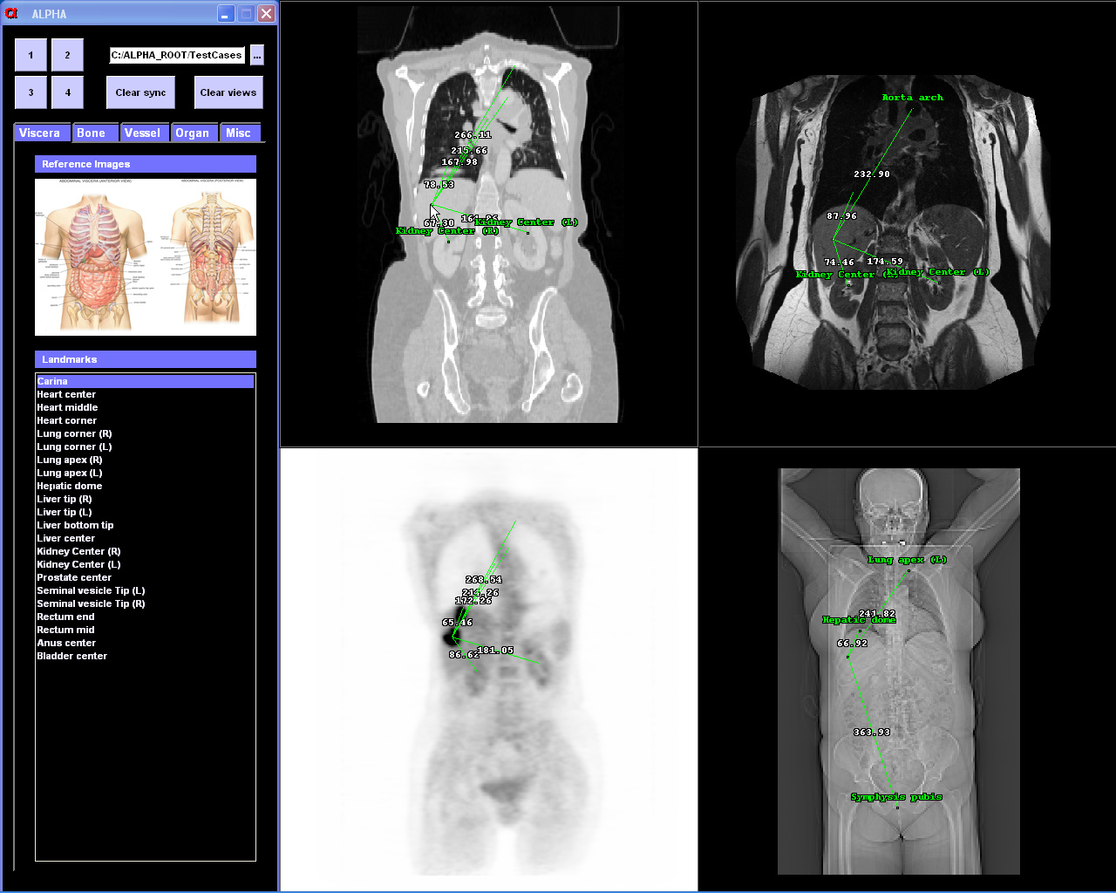
Technologie ALPHA Navigation entre modalités
PET/CT
CT
MR
Notes:
In summary, ALPHA provides the platform on which many future applications will be built.

Slide 21
Technologie ALPHA Navigation entre modalités
PET/CT
CT
MR
Notes:
We have only started to exploit this unique competitive advantage!

Slide 22
syngo.via Transformer de nombreuses données en résultats brillants
Lecture
Par organe*
Quantifier
*Basé sur les mises en pages MI SMART.
**Basé sur MI EQ•PET et les outils quantitatifs focntionnels.
Notes:
syngo.via for Molecular Imaging: Transforming Data into Brilliant Results
Our unique selling points –
Read Organ-based – SMART Layout and ALPHA
Quantify Reference-based – Quantification tools and EQ•PET
Report Evidence-based – Findings Navigator and evidence reporting

Slide 23
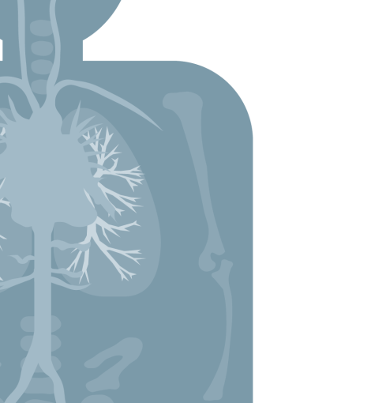
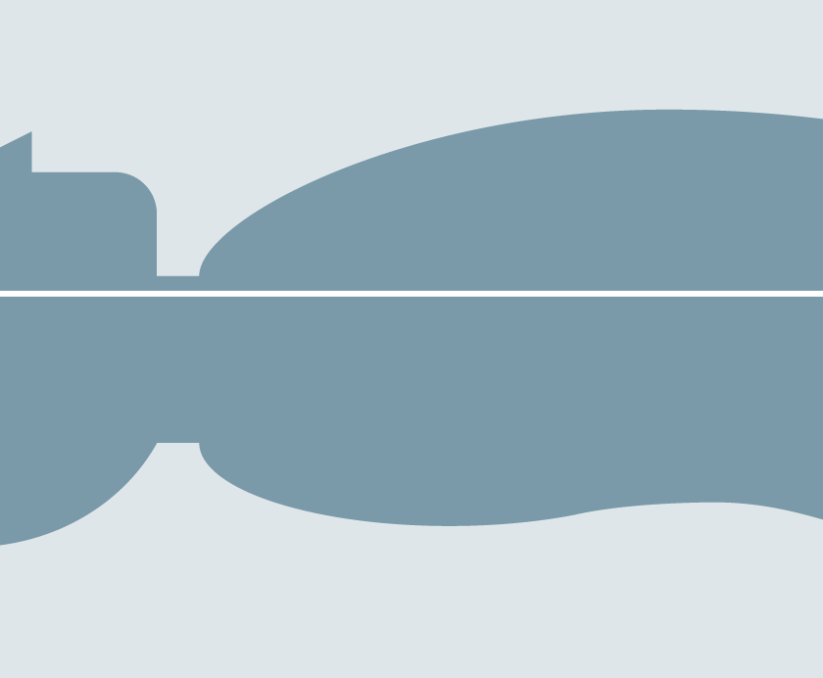

Quantifier Biograph mCT Flow: quantification précise en tout point
Contrôle qualité
Recalage
Bruit uniforme
Quanti•QC Normalization
SMART Correction
Noise Uniformity
SUV
OK
SUV
SUV
SUV
No Detector Drift
6
6
6
6
Notes:
Biograph mCT FlowTM with Organ-based Scanning advanced technologies in QA, Registration and Noise management to provide accurate quantification in all dimensions.

Slide 24
Quantifier Biograph mCT Flow: quantification précise en tout point
Contrôle qualité
Recalage
Bruit uniforme
Quanti•QC Normalization
SMART Correction
Noise Uniformity
-33%
SUV
OK
SUV
SUV
SUV
No Detector Drift
4
4
4
4
Quanti•QC Normalization
SMART Correction
Noise Uniformity
SUV
OK
SUV
SUV
SUV
No Detector Drift
6
6
6
6
Notes:
For follow-up scans, Biograph mCT Flow minimizes technology-induced variations in disease quantifications.
In this example, SUV pre-therapy is 6, post-therapy is 4–33% decrease in SUV.
According to PERCIST criterias, therapy is working.

Slide 25



Quantifier Les différentes technologies font de la quantification reproductible un défi
Contrôle qualité
Recalage
Bruit uniforme
Quanti•QC Normalization
SMART Correction
Noise Uniformity
-20%
SUV
OK
SUV
SUV
SUV
No Detector Drift
4
4
4
4
Daily Check only
Attennuation Correction
Inherent Noise
SUV
?
SUV
SUV
SUV
Detector Drift
2
3
5
5
Sources: QIBA-UPICT Onco. FDG-PET Protocol, v.1, 6-7-13. Lasnon et al. Harmonizing SUVs in multicenter trials when using different generation PET systems. EJNM.11-6-12. Partial metabolic response as min. 30% SUVpeak reduction. Wahl et al. From RECIST to PERCIST: Evolving Considerations for PET Response Criteria in Solid Tumors. JNM, May 2009 . .
Notes:
In cancer therapy follow-up, reading physicians frequently receive prior exams of their patients that have been acquired with different scanners.
The differences in scanner technologies result in different measurements.
If SUV quantification results are not normalized, conclusions about therapy might be incorrect.
In this example, SUV pre-therapy is 5, post-therapy is 4–20% therapy response assessment incorrectly suggests that therapy is not working.
Why different technologies result in different resolutions and quantifications?

Slide 26
Quantifier Les différentes technologies fournissent une résolution spatiale et une quantification différentes
-20%
SUV
4
Voxel
SUV
5
Sources: QIBA-UPICT Onco. FDG-PET Protocol, v.1, 6-7-13. Lasnon et al. Harmonizing SUVs in multicenter trials when using different generation PET systems. EJNM.11-6-12. Partial metabolic response as min. 30% SUVpeak reduction. Wahl et al. From RECIST to PERCIST: Evolving Considerations for PET Response Criteria in Solid Tumors. JNM, May 2009 . .
Notes:
Here is what happens when scanning the same voxel of activity with two different scanners.

Slide 27
Quantifier Les différentes technologies fournissent une résolution spatiale et une quantification différentes
-20%
SUV
4
Sharp Focus
SUV
5
Diffused Focus
Sources: QIBA-UPICT Onco. FDG-PET Protocol, v.1, 6-7-13. Lasnon et al. Harmonizing SUVs in multicenter trials when using different generation PET systems. EJNM.11-6-12. Partial metabolic response as min. 30% SUVpeak reduction. Wahl et al. From RECIST to PERCIST: Evolving Considerations for PET Response Criteria in Solid Tumors. JNM, May 2009 . .
Notes:
With conventional technology, focal area is diffused compared to the sharp focus obtained with Biograph mCT Flow.

Slide 28
Quantifier Les différentes technologies fournissent une résolution spatiale et une quantification différentes
SUV_{Siemens}
-20%
SUV
4
Sharp Focus
SUV_{Siemens}
SUV_{Conventional}
SUV
5
Diffused Focus
Sources: QIBA-UPICT Onco. FDG-PET Protocol, v.1, 6-7-13. Lasnon et al. Harmonizing SUVs in multicenter trials when using different generation PET systems. EJNM.11-6-12. Partial metabolic response as min. 30% SUVpeak reduction. Wahl et al. From RECIST to PERCIST: Evolving Considerations for PET Response Criteria in Solid Tumors. JNM, May 2009 . .
Notes:
Smudging across different focal area impacts SUV quantification results

Slide 29







Quantifier Les sociétés savantes demandent de réduire les variabilités entre systèmes
Sources: QIBA-UPICT Onco. FDG-PET Protocol, v.1, 6-7-13. Lasnon et al. Harmonizing SUVs in multicenter trials when using different generation PET systems. EJNM.11-6-12. Partial metabolic response as min. 30% SUVpeak reduction. Wahl et al. From RECIST to PERCIST: Evolving Considerations for PET Response Criteria in Solid Tumors. JNM, May 2009 . .
Notes:
Medical societies know that incomparable SUV quantification can cause incorrect therapy decisions.
This is why so many medical societies demand to reduce measurement variability across devices.

Slide 30
Quantifier Les sociétés savantes demandent de réduire les variabilités entre systèmes
“Improve the value and practicality of quantitative imaging biomarkers by reducing variability across devices, patients and time.”*
Sources: QIBA-UPICT Onco. FDG-PET Protocol, v.1, 6-7-13. Lasnon et al. Harmonizing SUVs in multicenter trials when using different generation PET systems. EJNM.11-6-12. Partial metabolic response as min. 30% SUVpeak reduction. Wahl et al. From RECIST to PERCIST: Evolving Considerations for PET Response Criteria in Solid Tumors. JNM, May 2009 . .
Notes:
RSNA QIBA Alliance is leading this clinical demand: reduce variability across devices.

Slide 31
Quantifier Des données montrent une variation de +86% / -54% suivant la technology*
+86%
“Improve the value and practicality of quantitative imaging biomarkers by reducing variability across devices, patients and time.”**
-54%
**Source: QIBA-UPICT_Oncologic_FDG-PETCT_Protocol_v1.0_Version_for_Public_Comment_6-7-13[1
*Source: EQPET White Paper. Lasnon et al: Harmonizing SUVs in multicenter trials when using different generation PET systems: prospective validation in non-small cell lung cancer patients., in EJNM, 11/6/2012
Source: Based on competitive literature available at time of publication. Data on file.
Notes:
Clinical data suggests that technology-induced measurement variation can be as high as 86%.

Slide 32
Quantifier Les seuils PERCIST sont de +30% et de -30% pour évaluer le succès d’une thérapie*
+86%
Change Therapy
+30% PERCIST
“Improve the value and practicality of quantitative imaging biomarkers by reducing variability across devices, patients and time.”**
-30% PERCIST
Continue Therapy
-54%
*Source: Partial metabolic response defined as a minimum of 30% reduction in SUVpeak. R. Wahl et al, “From RECIST to PERCIST: Evolving Considerations for PET Response Criteria in Solid Tumors”, JNM May 2009
**Source: QIBA-UPICT_Oncologic_FDG-PETCT_Protocol_v1.0_Version_for_Public_Comment_6-7-13[1
Source: Based on competitive literature available at time of publication. Data on file.
Notes:
Progressive disease and therapy response threshold in PERCIST measurement are at +30% and -30%.
Technology variations must be within this threshold.
Imagine what the impact will be on the industry if Siemens could bring this variation into the threshold??????
Introducing a Siemens unique technology breakthrough: technology that solves a long-standing problem in the industry… EQ•PET

Slide 33
Quantifier L’étude par le centre François Baclesse confirme que EQ•PET résout le problème*
Conventionnel
EQ•PET
+86%
Change Therapy
+30% PERCIST
+18%
-16%
-30% PERCIST
Continue Therapy
-54%
Source: Partial metabolic response defined as a minimum of 30% reduction in SUVpeak. R. Wahl et al, “From RECIST to PERCIST: Evolving Considerations for PET Response Criteria in Solid Tumors”, JNM May 2009
*Source: EQPET White Paper, Clinical study by François Baclesse Cancer Centre, Caen, France
Source: Based on competitive literature available at time of publication. Data on file.
Notes:
Clinical study by Cancer Centre, Caen, France, confirmed that Siemens EQ•PET solved this problem.
While maintaining superb image quality for visualization, quantification is now comparable.
How is it done?

Slide 34
Quantifier EQ•PET fournit des SUV (suivant NEMA) comparables quelque soit la technologie
SUV_{Siemens}
-33%
SUV_{EQ}
SUV_{EQ}
2
Sharp Focus
SUV_{Siemens}
SUV_{Conventional}
SUV_{EQ}
SUV_{EQ}
3
Diffused Focus
Notes:
EQ•PET provides comparable NEMA-referenced SUV across technologies.
While maintaining image quality for visualization, quantification is comparable now.

Slide 35



Quantifier Un problème insoluble depuis le commencement du TEP
“It is therefore beyond any doubt that standardization is needed for the use of quantitative 18F-FDG PET/CT as an imaging biomarker.”
“…scans should be performed on the same PET scanner.”
“[for] different generation PET systems, we recommend the reconstruction of two image sets, one for optimal visual analysis and one for standardized quantification, whilst awaiting future development that might allow for both analyses to be done on the same dataset.”
Notes:
Since the beginning of PET, everyone has been excited about the inherent quantitative capabilities of the modality
However, it was soon discovered that the standard uptake value SUV was not as standard as everybody had hoped for (Silly Useless Value)
In fact, many publications have addressed the issue and proposed possible workarounds to compensate for lack of standardization
For example, Wahl, inventor of PERCIST, stated that accurate results can only be obtained when follow-up studies are being performed on the same PET scanner. This avoids the introduction of technology-induced variations
Other groups even propose TWO reconstructions: one for optimal visual analysis and one for standardized quantification
All are anxiously awaiting future developments that allow for both analyses to be done on the same data set
The future is here thanks to syngo.via for Molecular Imaging.

Slide 36



Quantifier Etude clinique : Centre François Baclesse, Caen, France
Pré-thérapie
Post-thérapie
Décision thérapeutique
+92%
Change
HD•PET
OSEM
OSEM
+10%
Ne change pas
OSEM
+9%
Ne change pas
HD•PET EQ
Notes:
So why is comparable SUV quantification so critically important?
Here you can see the results of a study conducted at François Baclesse Cancer Centre, Caen, France
They conclude that technology induced variations, such as different reconstructions of the same data set, can lead to drastically changed quantification and subsequently lead to false therapy decisions

Slide 37

Quantifier Ce qui se cache derrière EQ•PET: courbes de contraste NEMA
Patient
PET
EQ•PET
Créer une référence NEMA.
Analyser les courbes.
EQ•PET Parameter
1.
2.
3.
Indiquer les Paramètres EQ dans syngo.via pour correspondre à la référence NEMA.
NEMA Reference
PET Recovery Curve
EQ•PET Recovery Curve
Notes:
So what have we done about it?
The solution is to use a common reference for quantification: The NEMA reference
This is how the science behind EQ•PET works:
First, the NEMA phantom is prepared with defined and known activity.
It is then scanned
Next, the PET scanner-specific recovery curve is computed based on a comparison of output values relative to the known NEMA reference
Then, in syngo.via, the EQ•PET parameter is set such that the recovery curve matches NEMA tolerances
Now, patients can undergo scanning and their quantitative values will now be comparable thanks to the normalized recovery curve

Slide 38




Quantifier EQ•PET: fonctionne pour tous les scanners, toutes les reconstructions, quelque soit le temps
Patient
PET
EQ•PET
Créer une référence NEMA.
Analyser les courbes.
EQ•PET Parameter
1.
2.
3.
Indiquer les Paramètres EQ dans syngo.via pour correspondre à la référence NEMA.
NEMA Reference
PET Recovery Curve
EQ•PET Recovery Curve
Notes:
So how can our customer achieve these results in clinical routine?
Let’s look at an example:
First …
Does it work with other scanners as well?
Yes, in fact it works for all scanners and all reconstructions all the time!

Slide 39

Quantifier EQ•PET: fonctionne pour tous les scanners, toutes les reconstructions, quelque soit le temps
Patient
PET
EQ•PET
Créer une référence NEMA.
Analyser les courbes.
EQ•PET Parameter
1.
2.
3.
Indiquer les Paramètres EQ dans syngo.via pour correspondre à la référence NEMA.
NEMA Reference
PET Recovery Curve
EQ•PET Recovery Curve
Notes:
Regardless of whether or not it is a previous-generation Siemens system, or competitive system.

Slide 40

Quantifier EQ•PET: Tous les utilisateurs peuvent implémenter eux-mêmes suivant un processus décrit
Patient
PET
EQ•PET
EQ•PET Parameter
1.
2.
3.
NEMA Reference
PET Recovery Curve
EQ•PET Recovery Curve
Notes:
Our customers can simply implement EQ•PET by themselves, following the process described in the EQ•PET white paper.

Slide 41

Quantifier EQ•PET: Toutes les informations sont disponibles dans le whitepaper
Patient
PET
EQ•PET
EQ•PET Parameter
1.
2.
3.
NEMA Reference
PET Recovery Curve
EQ•PET Recovery Curve

Slide 42

Quantifier Oncologie : syngo.via EQ•PET permet la comparaison de SUV

Slide 43


Quantifier EQPET : la solution.
First, as concluded by the authors, it is no longer necessary to
sacrifice superior lesion detectability obtained with advanced
and new PET technologies for harmonizing quantitative PET/CT
system performance.
…
At the same time it opens the door to the use of quantitative
FDG PET/CT imaging in multicentre clinical trials.
These data indicate that it is not necessary to sacrifice the
superior lesion contrast and image quality achieved by newer
reconstruction techniques in the quest for harmonizing quantitative
comparability between PET systems.
Notes:
This is syngo.via unique selling point: quantify reference-based.

Slide 44

Merci de votre attention
Syngo.VIA
Dispositif médical de Classe IIa
CE, TÜV SÜD n°0123
Fabricant : Siemens AG, Münich, Allemagne
Veuillez lire attentivement le manuel d’utilisation de l’équipement.

